Slide 1

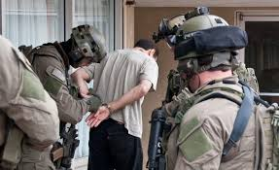
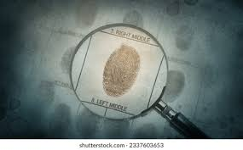

FBI Crime Time Forecasting
BY:
Meghasham Parab

Slide 2

Overview of Dataset
Feature | Description | Data Type
TYPE | The type of crime (e.g., Other Theft, Mischief, etc.) | Categorical (Object)
HUNDRED_BLOCK | Block-level location where the crime occurred | Categorical (Object)
NEIGHBOURHOOD | Neighborhood where the crime took place | Categorical (Object)
X | X-coordinate for mapping | Numerical (float64)
Y | Y-coordinate for mapping | Numerical (float64)
Latitude | Latitude of the crime location | Numerical (float64)
Longitude | Longitude of the crime location | Numerical (float64)
HOUR | Hour when the crime occurred | Numerical (float64)
MINUTE | Minute when the crime occurred | Numerical (float64)
YEAR | Year of the crime incident | Numerical (int64)
MONTH | Month of the crime incident | Numerical (int64)
DAY | Day of the crime incident | Numerical (int64)
Date | Timestamp of the crime event | DateTime
This report analyzes FBI crime data over time, including distribution by type, neighborhood, year, month, day, and time. The objective is to forecast trends and identify crime patterns.

Slide 3
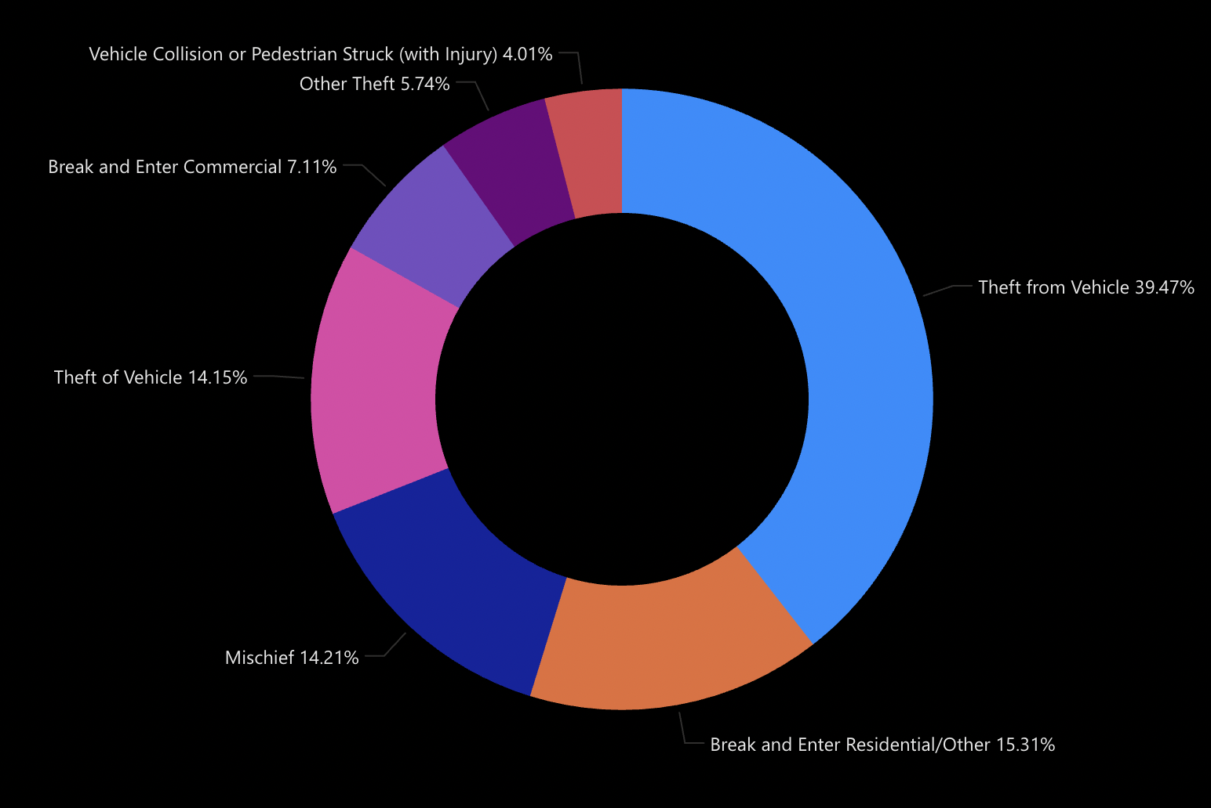
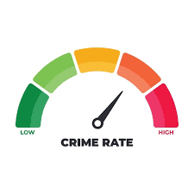
Crime Distribution by Type
• Mischief: 37.95%
• Theft from Vehicle: 15.59%
• Break and Enter Residential: 13.94%
• Other Theft: 10.75%
• Theft of Vehicle: 8.92%
• Break and Enter Commercial: 7.41%

Slide 4
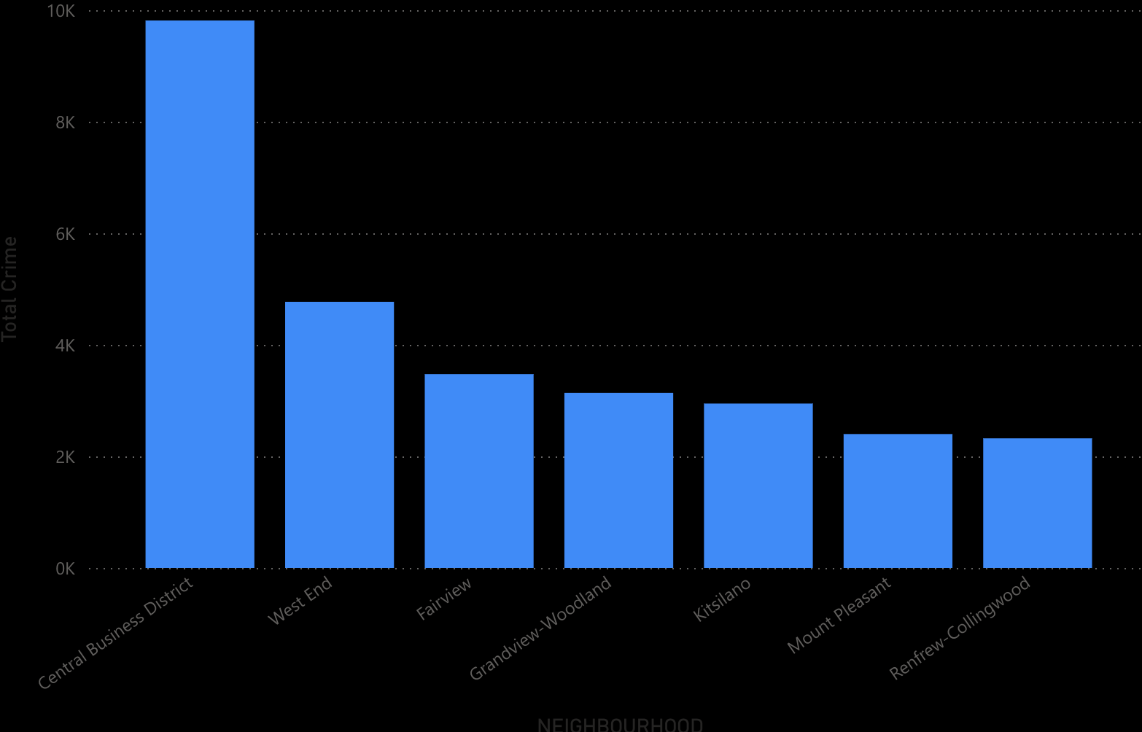
Crime by Neighborhood
• West End: 36.72%
• Fairview: 14.11%
• Kitsilano: 11.22%
• Central Business District: 9.21%
• Mount Pleasant: 9.2%
• Grandview-Renfrew-Collingwood: 9.29%

Slide 5
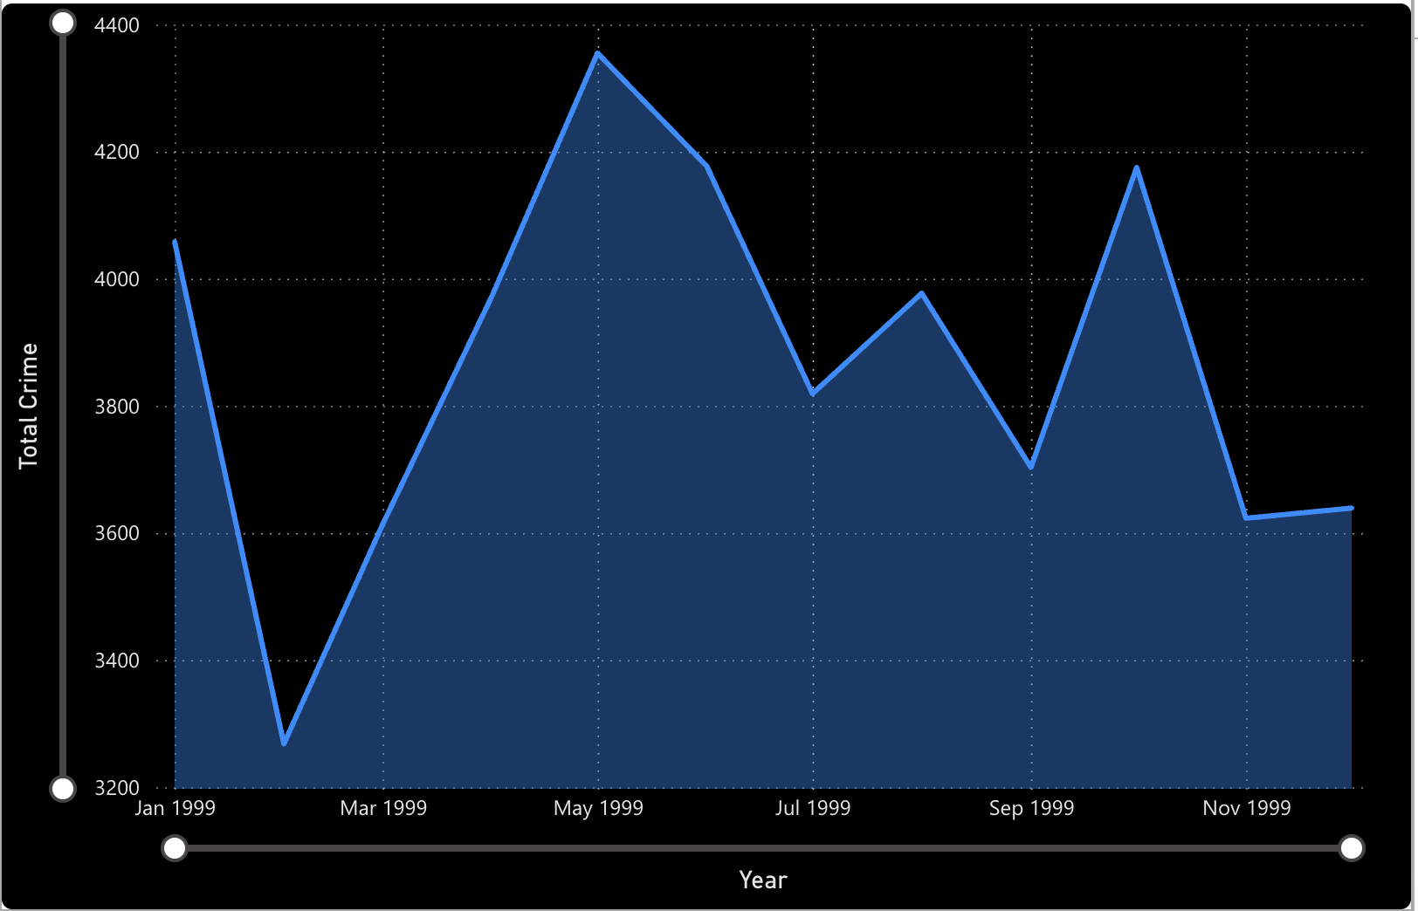
Crime by Year and Month
Crime trends from 2009-2011 show steady increase.
Peaks in crime occur around certain months, indicating seasonal trends.

Slide 6
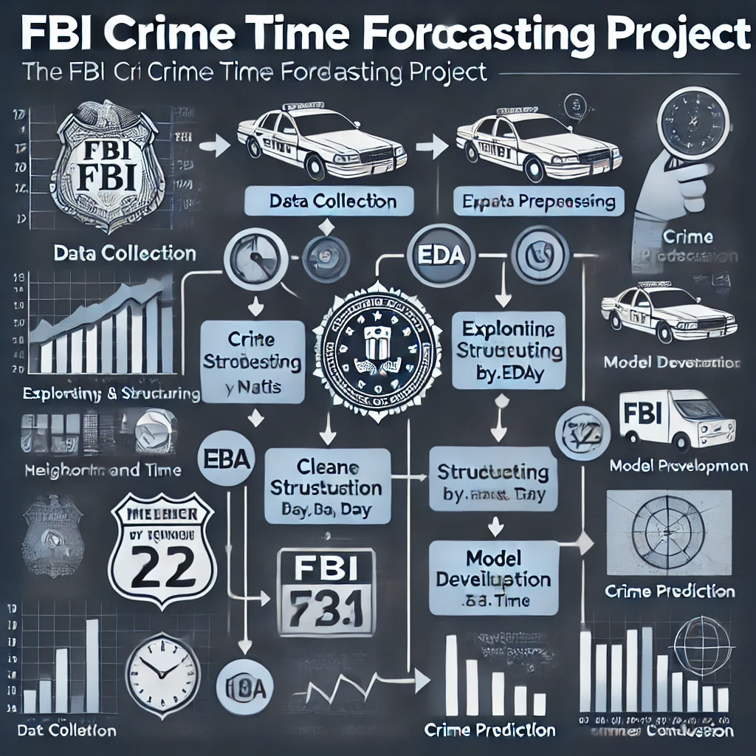

Overview Of The Project
1. Data Collection
2. Data Preprocessing
3. Exploratory Data Analysis (EDA)
Visualization: Graphs showing crime distribution by:
Type (theft, vandalism, etc.)
Neighborhoods (West End, Fairview, etc.)
Time (year, month, day, hour).
4. Model Development
5. Crime Prediction
6. Insight and Conclusion

Slide 7
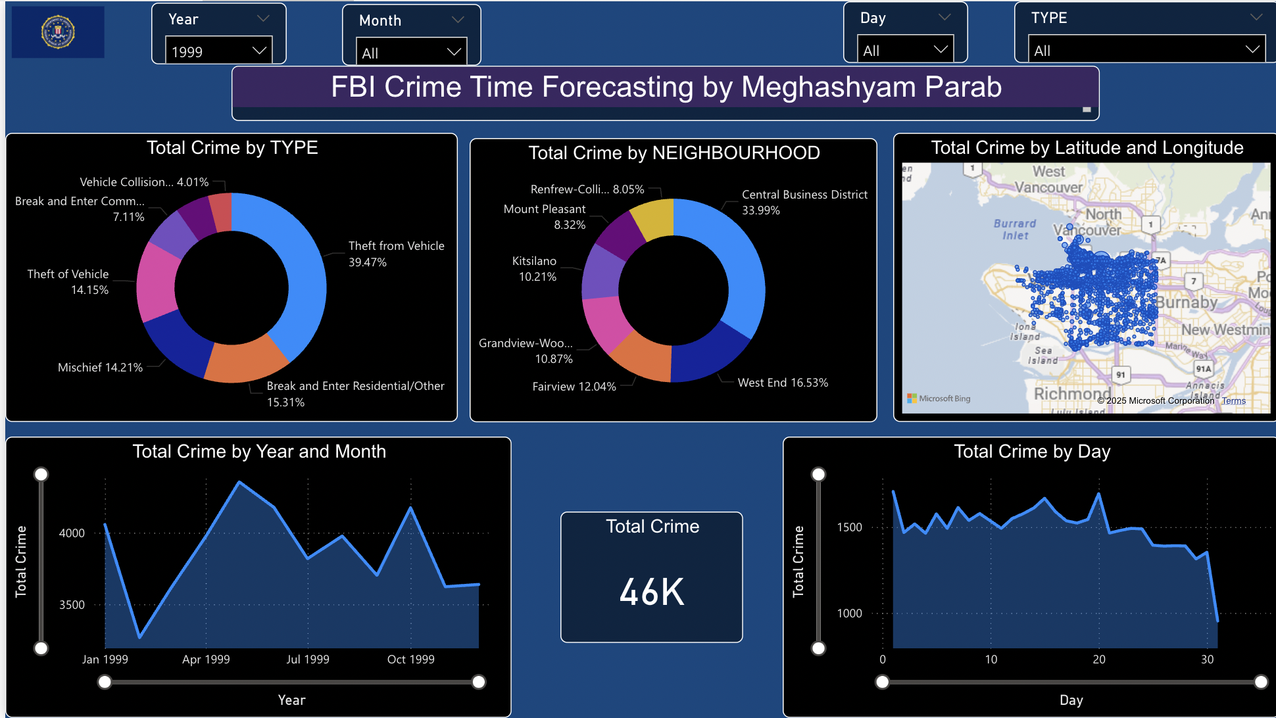


Analysing And Visualizing Data On Power BI Platform

Slide 8
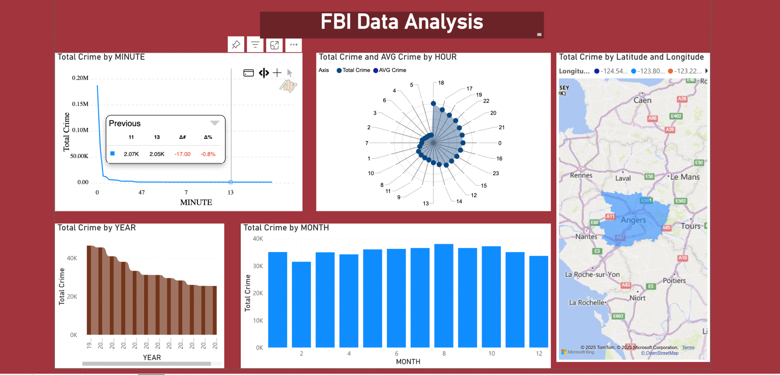

Slide 9

Conclusion
The FBI crime time series report reveals significant patterns in crime distribution by type, neighborhood, and time. Such insights can help law enforcement in allocating resources effectively and implementing crime prevention strategies.

